Slide 1
ARRAY MULTIPLIER AND BOOTH RADIX4 MULTIPLIER

Slide 2
INTRODUCTION
For centuries, mathematical functions were realized mechanically allowing operations like multiplication to be accomplished in a few seconds.
In the twentieth century, computing equipment evolved into electromechanical systems capable of performing multiple multiplications per second and finally, by the 1950s, into totally electronic machines executing thousands of arithmetic operations per second.

Slide 3
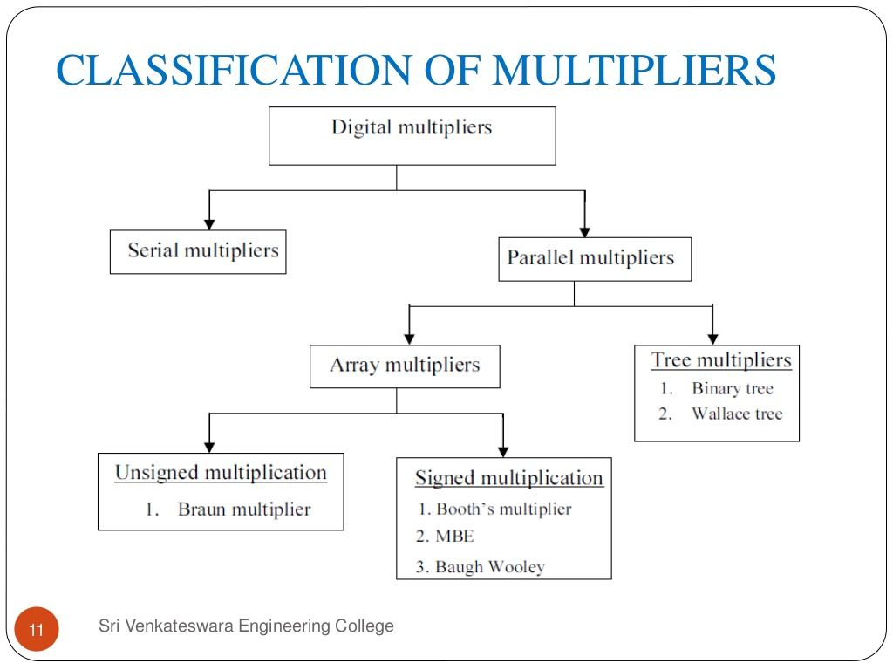

Slide 4
Among these multipliers, we will be explaining and comparing ARRAY MULTIPLIER and BOOTH RADIX4 MULTIPLIER

Slide 5
ARRAY MULTIPLIER
Array multipliers are the most popular kinds of multiplier.
Multiplication consists of three steps:
1) generation of partial products,
2) accumulation of all partial production to get only two rows at the end and last two rows of partial products are added by using a carry propagation adder.
3) Last step is to efficiently add the two rows of partial products which can be fastened by using appropriate adder structure (full adder or half adder).

Slide 6
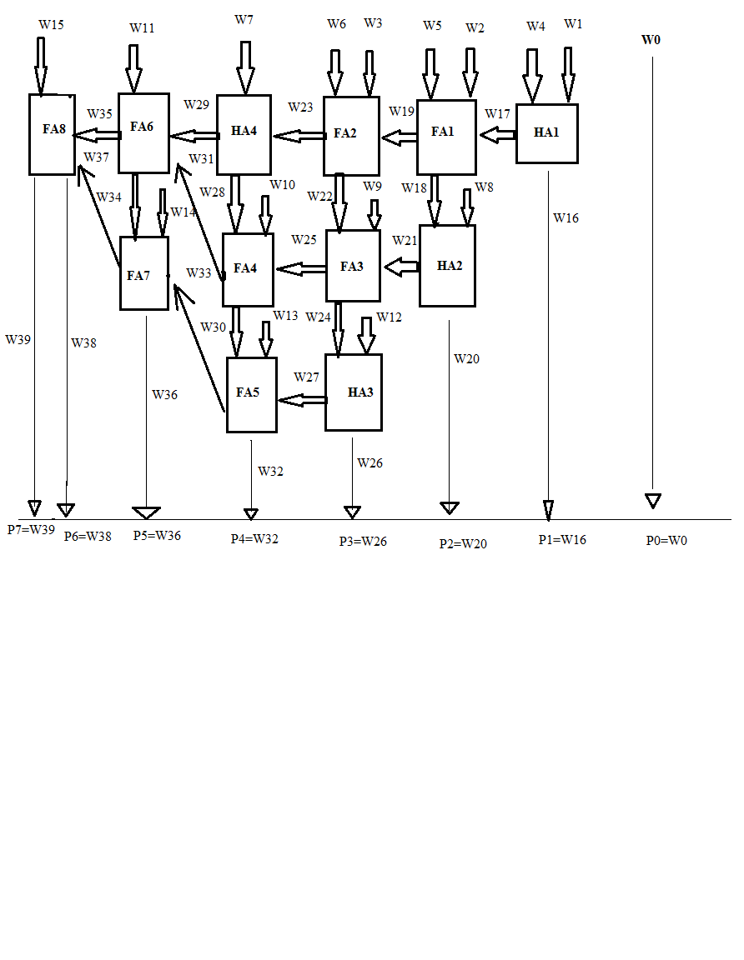
BLOCK DIAGRAM

Slide 7
ALGORITHM
Multiplier circuit is based on add and shift algorithm.
Each partial product is generated by the multiplication of the multiplicand with one multiplier bit.
The partial product are shifted according to their bit orders and then added.
The addition can be performed with normal carry propagate adder. N-1 adders are required where N is the multiplier length.
If there are mn summands that are produced in parallel by a set of mn AND gates – n x n multiplier requires n(n-2) full adders, n half-adders and n2 AND gates – Worst case delay would be (2n+1)td.

Slide 8
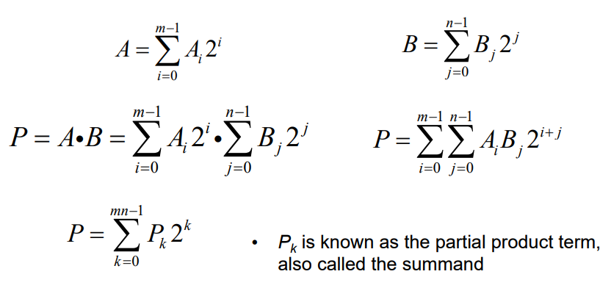

Slide 9
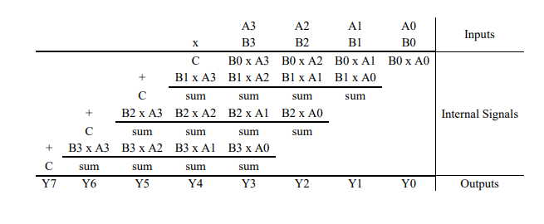

Slide 10
BOOTH RADIX4 MULTIPLIER
Booth's algorithm examines adjacent pairs of bits of the 'N'-bit multiplier Y in signed two's complement representation, including an implicit bit below the least significant bit, y₋₁ = 0.
For each bit y_{i}, for I running from 0 to N − 1, the bits y_{i} and y_{i−1} are considered.
Where these two bits are equal, the product accumulator P is left unchanged.

Slide 11
Where y_{i} = 0 and y_{i−1} = 1, the multiplicand times 2^{i} is added to P; and where y_{i} = 1 and y_{i−1} = 0, the multiplicand times 2^{i} is subtracted from P.
The final value of P is the signed product.
The representations of the multiplicand and product are not specified; typically, these are both also in two's complement representation, like the multiplier, but any number system that supports addition and subtraction will work as well.

Slide 12
As stated here, the order of the steps is not determined.
Typically, it proceeds from LSB to MSB, starting at i = 0; the multiplication by 2^{i} is then typically replaced by incremental shifting of the P accumulator to the right between steps; low bits can be shifted out, and subsequent additions and subtractions can then be done just on the highest N bits of P.^{[2]}

Slide 13
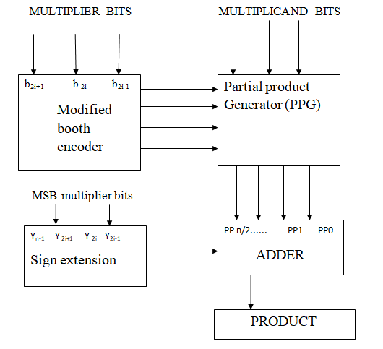
BLOCK DIAGRAM

Slide 14
ALGORITHM
Booth's algorithm can be implemented by repeatedly adding (with ordinary unsigned binary addition) one of two predetermined values A and S to a product P, then performing a rightward arithmetic shift on P.
Let m and r be the multiplicand and multiplier, respectively; and let x and y represent the number of bits in m and r.
Determine the values of A and S, and the initial value of P. All of these numbers should have a length equal to (x + y + 1).

Slide 15
A: Fill the most significant (leftmost) bits with the value of m. Fill the remaining (y + 1) bits with zeros.
S: Fill the most significant bits with the value of (−m) in two's complement notation. Fill the remaining (y + 1) bits with zeros.
P: Fill the most significant x bits with zeros. To the right of this, append the value of r. Fill the least significant (rightmost) bit with a zero.
Determine the two least significant (rightmost) bits of P.
If they are 01, find the value of P + A. Ignore any overflow.
If they are 10, find the value of P + S. Ignore any overflow.
If they are 00, do nothing. Use P directly in the next step.
If they are 11, do nothing. Use P directly in the next step.

Slide 16
Arithmetically shift the value obtained in the 2nd step by a single place to the right. Let P now equal this new value.
Repeat steps 2 and 3 until they have been done y times.
Drop the least significant (rightmost) bit from P. This is the product of m and r.[3]

Slide 17
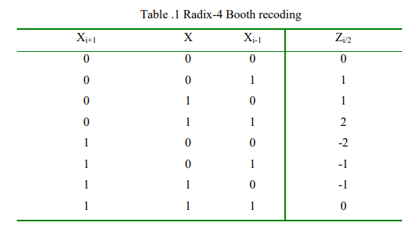
TABLE FOR BOOTH RADIX 4

Slide 18
COMPARISON
Logic Utilization | Array Multiplier | Radix 4
Number of slices | 483 | 102
Number of LUT’s | 483 | 102
Number of bonded IOB’s | 66 | 66
Utilization (%) | 0.91 | 0.19
On Chip Power [Watt] | 44.861 | 28.817
Junction Temperature [⁰C] | 125 | 125

Slide 19
APPLICATION
With recent rapid increase in growing, more and more sophisticated signal processing systems are being implemented on a VLSI chip. These signal processing applications not only demand great computation capacity but also consume considerable amounts of energy.

Slide 20
While performance and area remain to be two major design goals, power consumption has become a critical concern in today’s VLSI system design
Multiplication is a fundamental operation in most arithmetic computing systems. Multipliers have large area, long latency and consume considerable power.
So booth’s algorithm technique is used in binary multiplier which is an integral part of the arithmetic logic unit (ALU)

